Slide 1


SVAP-Presentation
TEAM-6
Britannia Industries Limited FY-2020 Stock Data Analysis
1. Fathima Hafeez
2.Puneeth
3. Abdul Karim

Slide 2

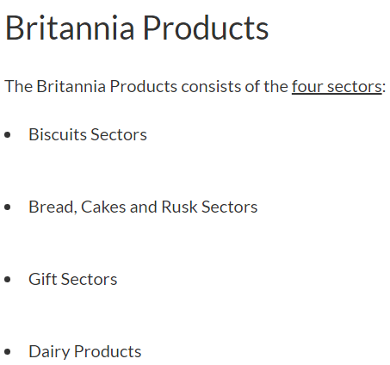

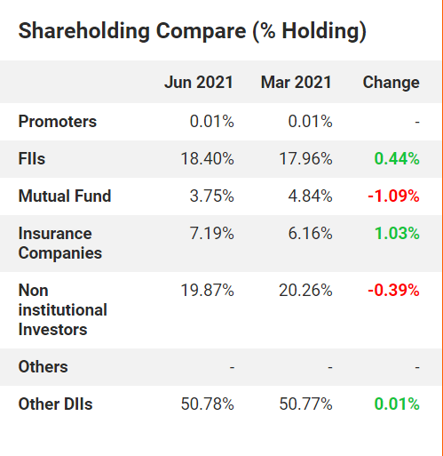
Britannia - Logo and its Meaning
As explained by a spokesperson of Britannia, Britannia's new logo signifies, rebranding as the Total Foods Company from now on with the expansion of its offerings in both healthy and indulgent products.
The wings of a bird signify freedom to choose, whenever and wherever you want to enjoy your food
Britannia - Business Model
The company operates in two business segments, namely, bakery products and dairy products. The company derives ~95% of its revenue from the biscuits segment while, ~5% of its total sales coming from non-biscuits category (dairy) and International market.

Slide 3
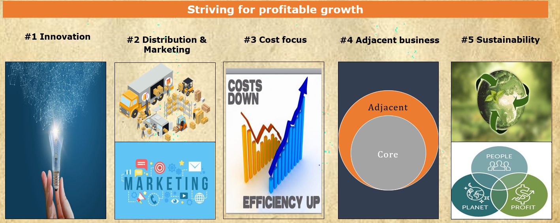

Slide 4
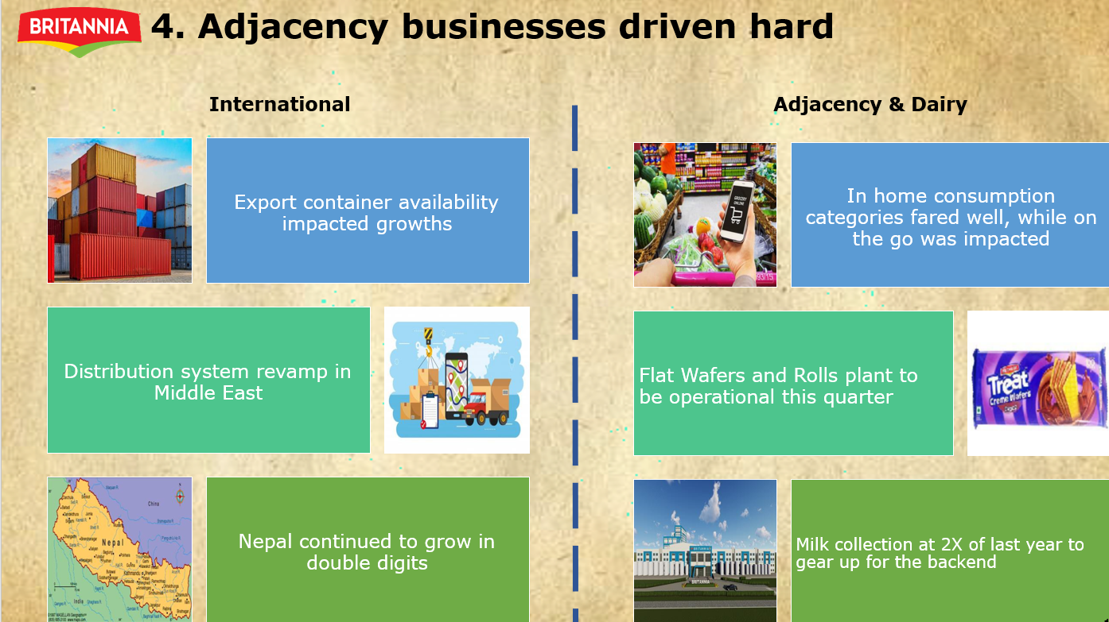

Slide 5
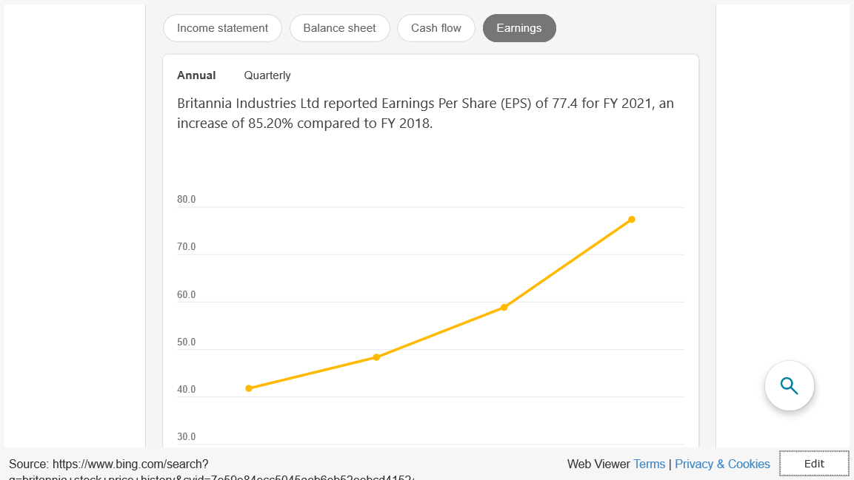

Slide 6
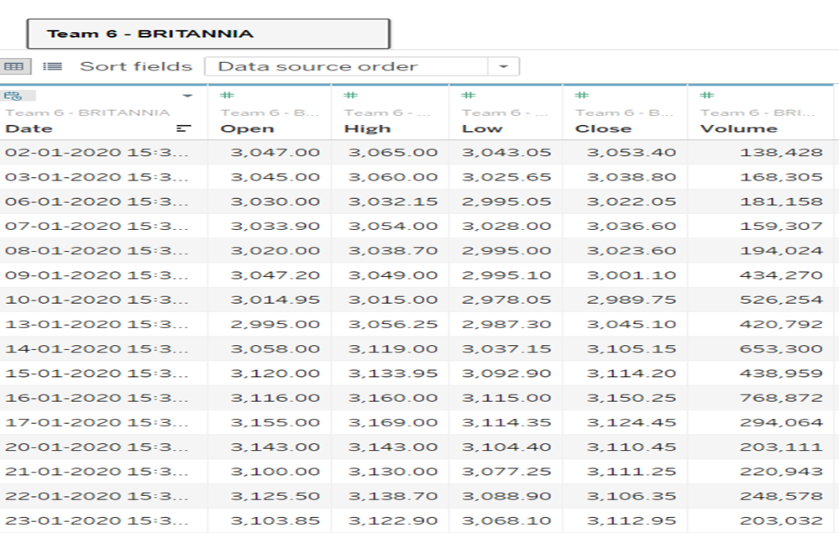
DATA SET:

Slide 7
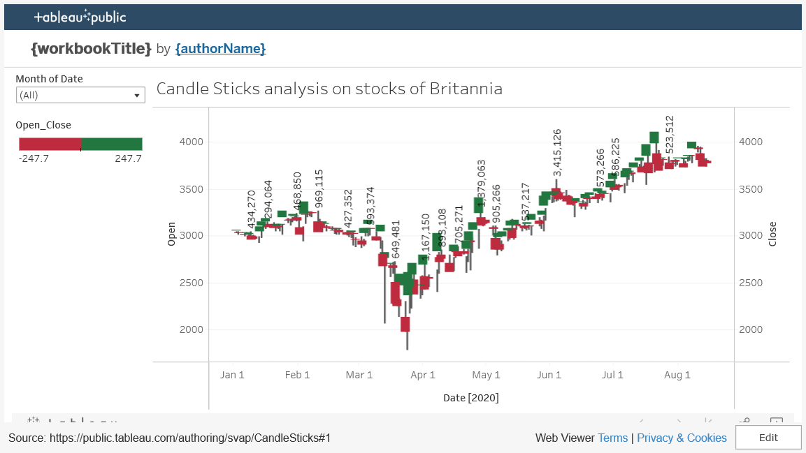
Candle Chart – Daily Stock Price Variation

Slide 8
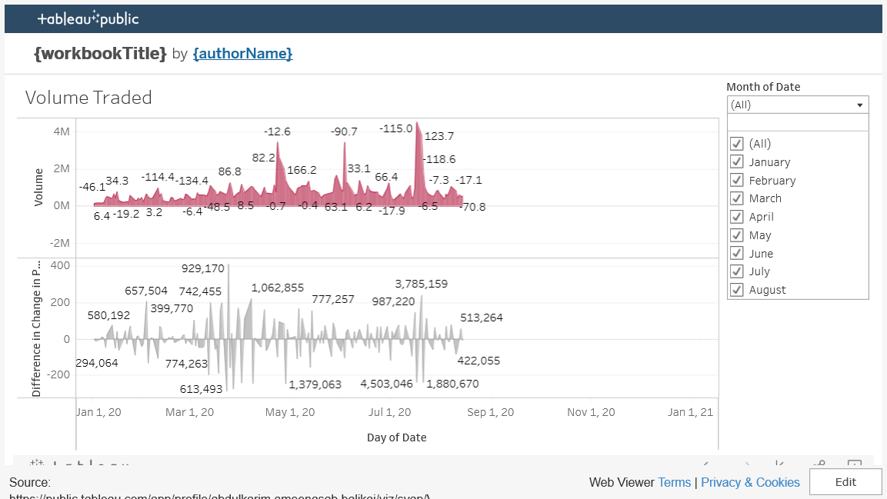
Volume Traded analysis of the business processes

Slide 9
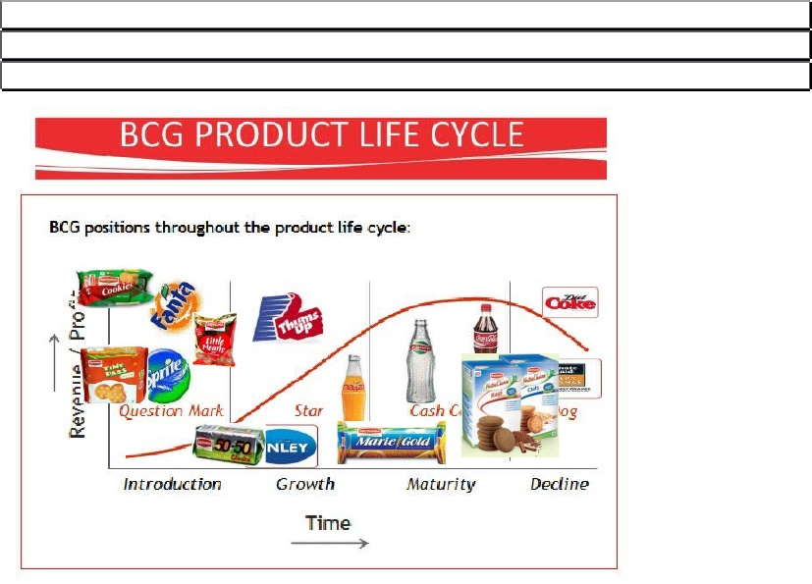
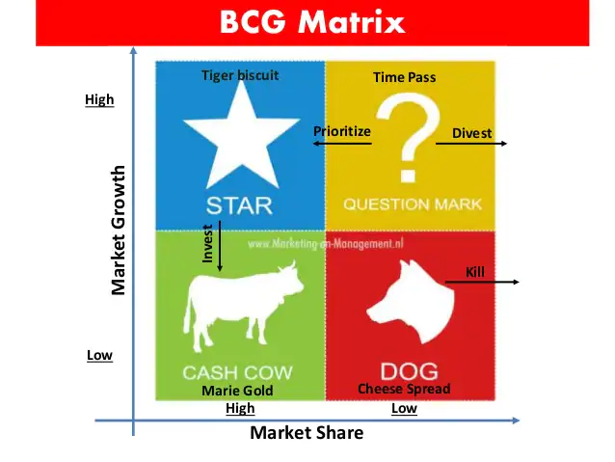
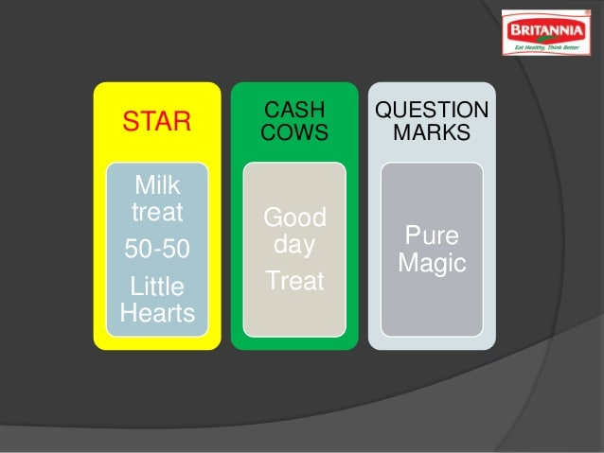

Slide 10
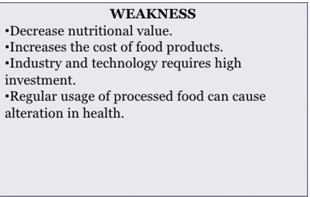
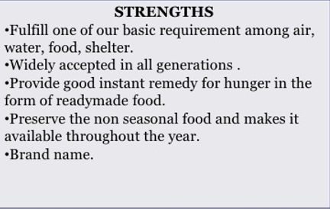
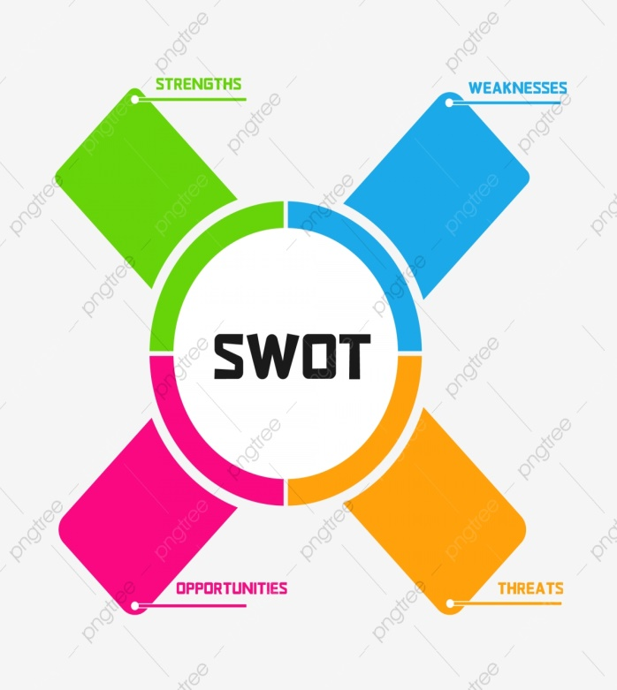
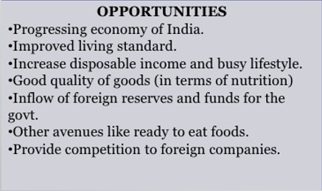
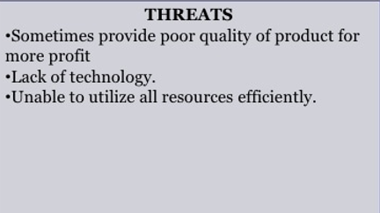
SWOT analysis of the business processes

Slide 11
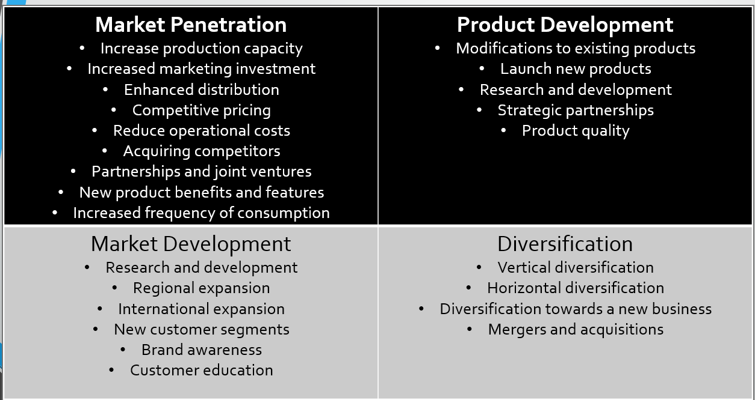
Ansoff Matrix analysis of the business processes

Slide 12
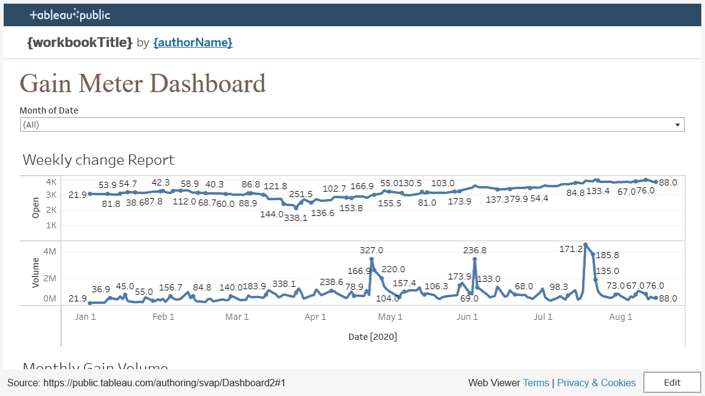
Stock Meter Gained

Slide 13










Biscuit Market Share %
Market Share
Britannia
32 .0
Largest Competitor
2nd Largest Competitor
30 .0
28 .0
26 .0
24 .0
22 .0
20 .0
12-13 13-14 14-15 15-16 16-17 17-18
18-19 19-20 20-21 YTD 21-22
Source: Company Financials – Consolidated Results

Slide 14
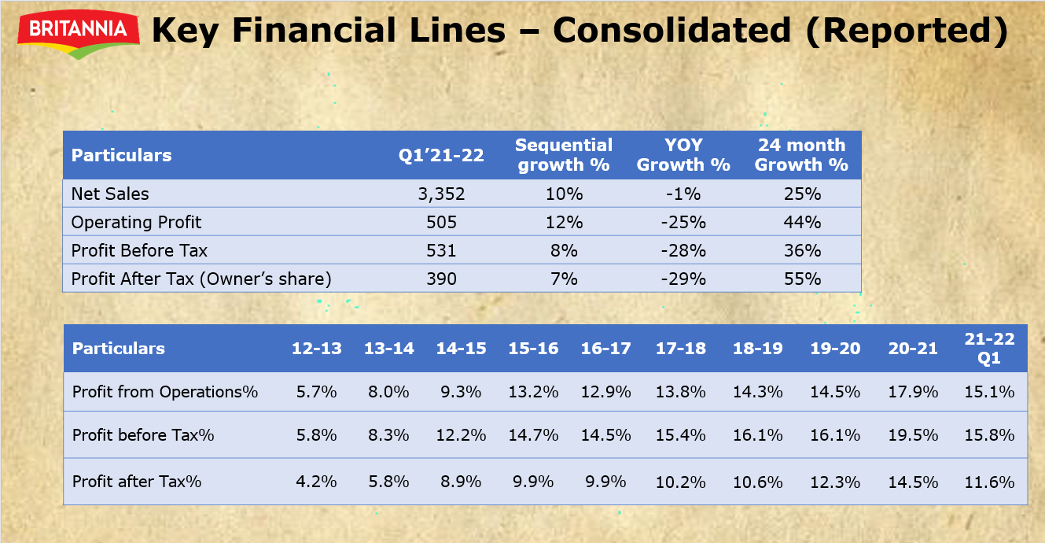
Source: Company Financials – Consolidated Results

Slide 15


